Slide 1
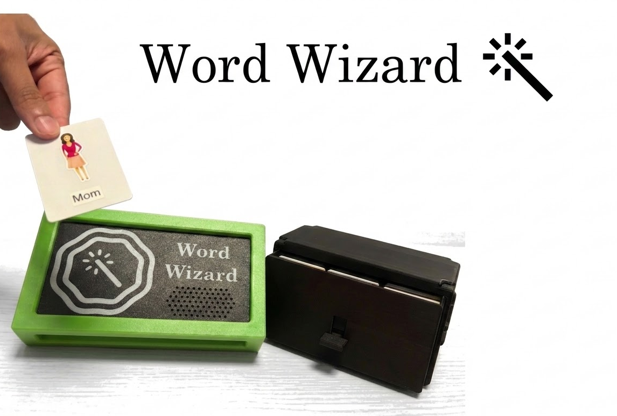

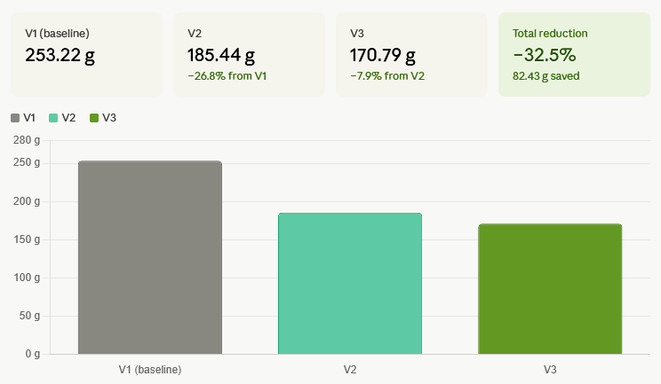
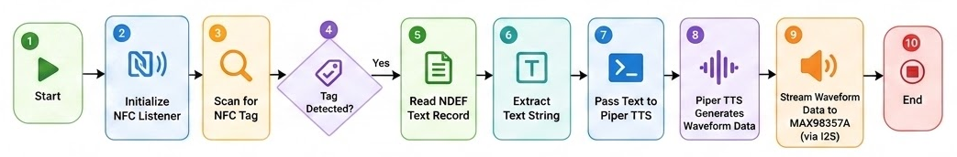
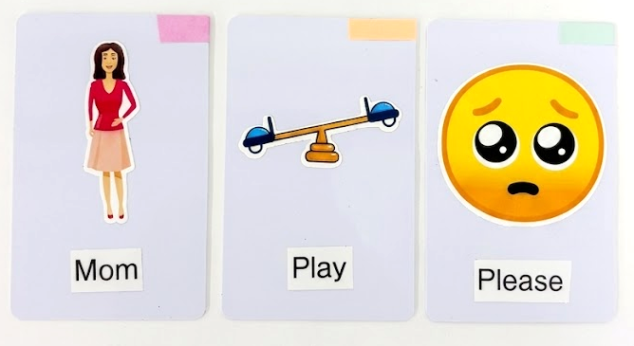
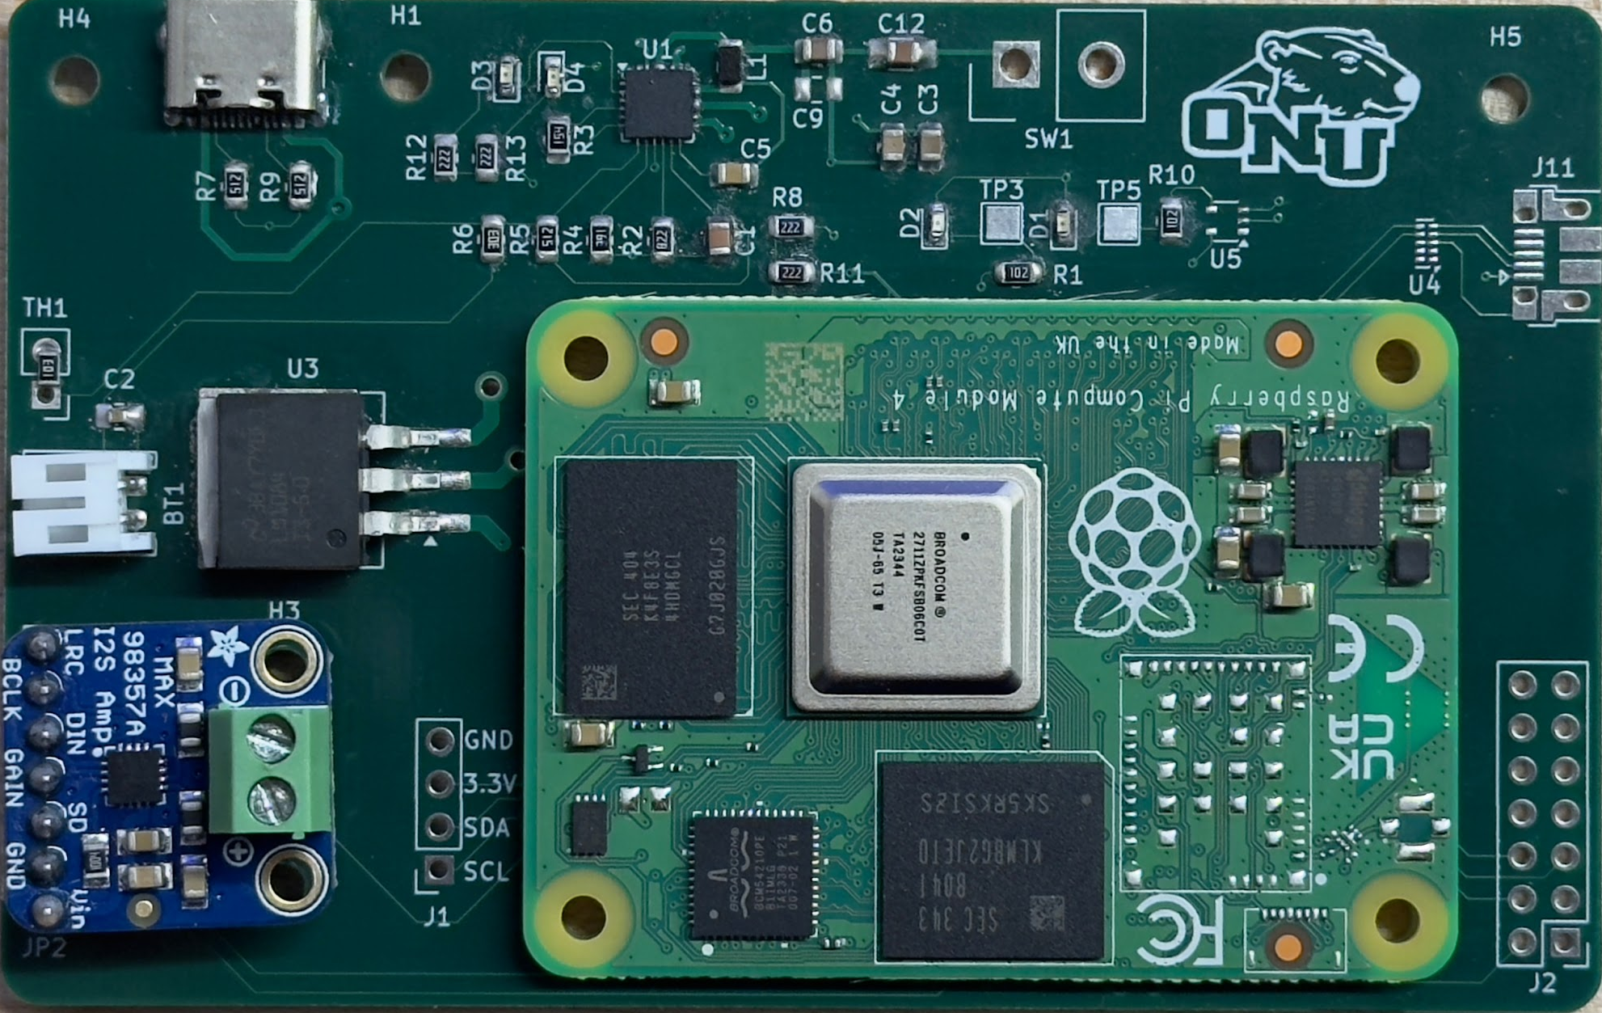
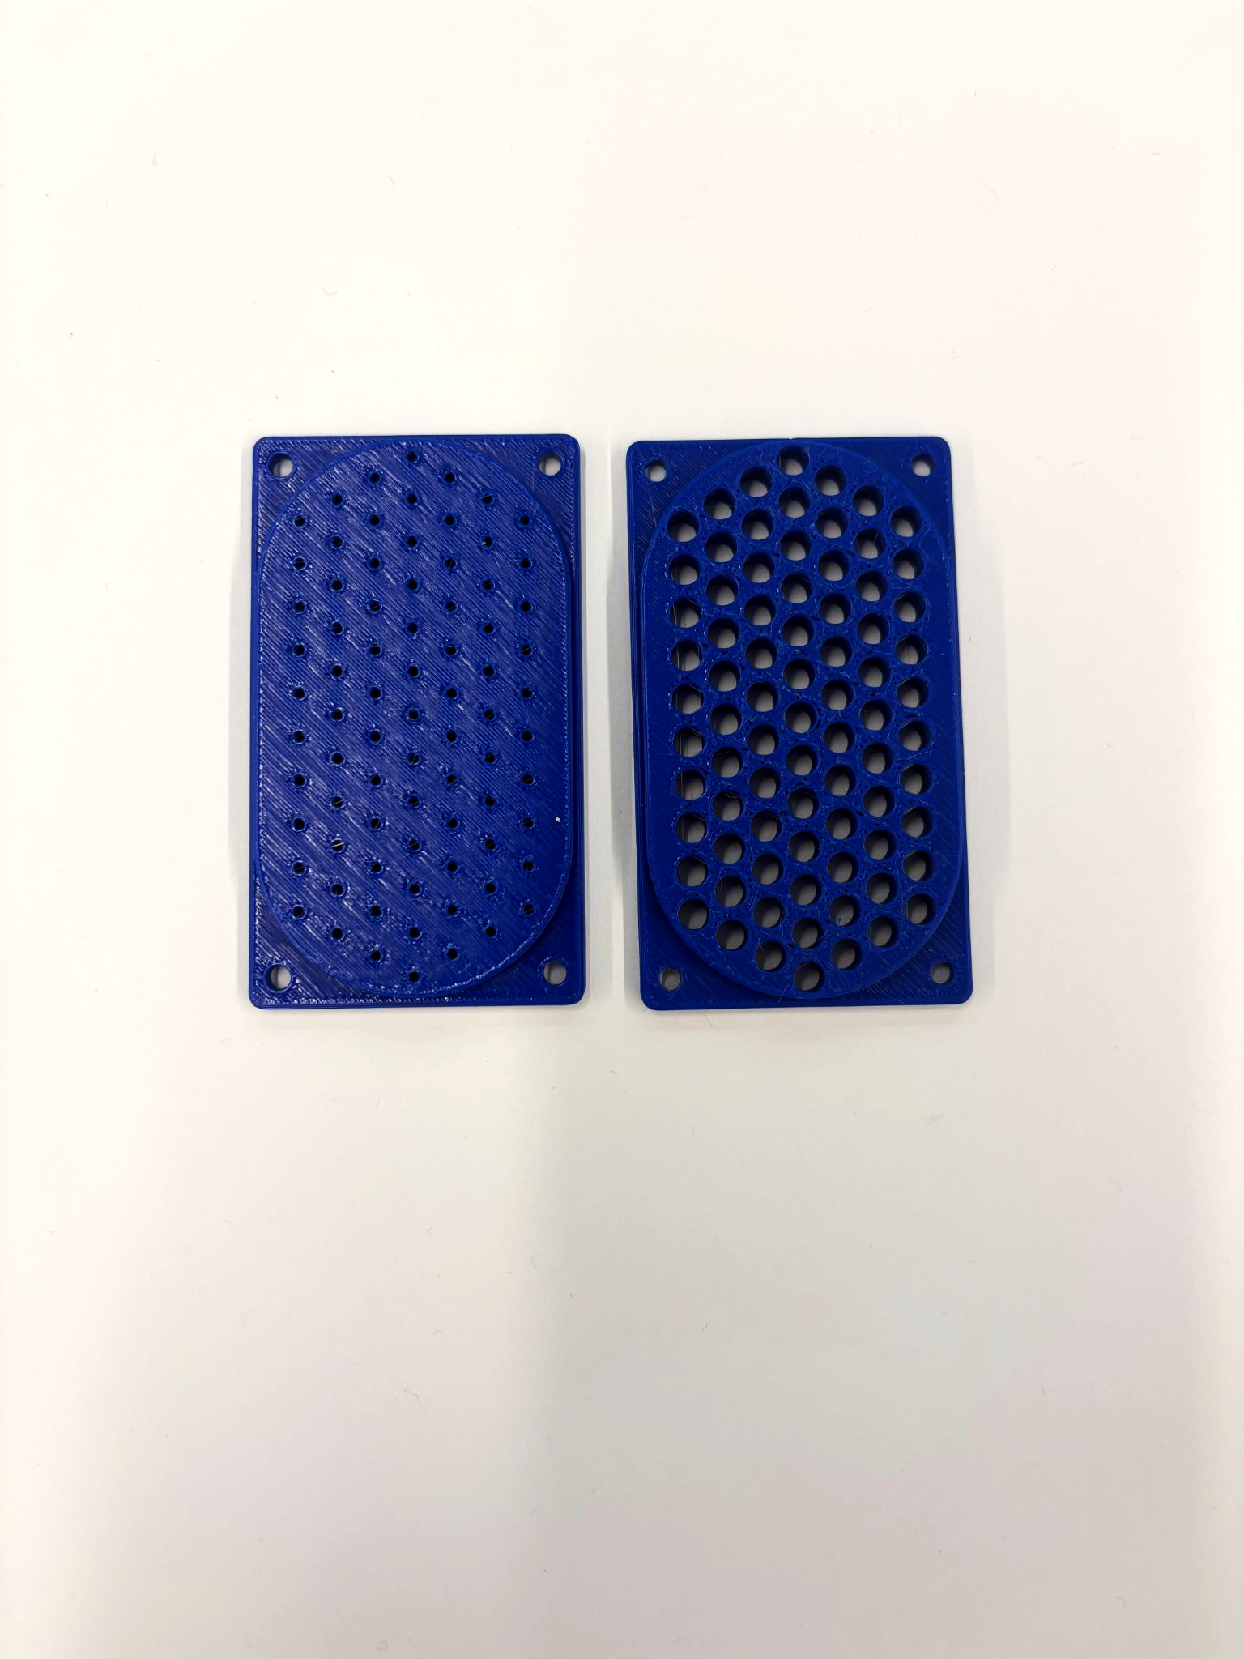
Opportunity:
Creating a customizable device that takes physical input and turns it into audio output to improve the communication of non-verbal children.
Word Wizard
Broader Impacts:
High potential as screen-free learning tool ⇨ larger market
Key Research:
Minimal mid tech non-verbal communication options exist
60-65 dB is needed for high quality sound output
Key Design Specifications:
Sound level, dB,⇧
Battery Life, hrs, ⇧
Portability, g, ⇩
10 am
Team 5
Next Steps:
Create easier storage system.
Merge storage with the main device.
Plastic Reduction:
Program Flow Chart:
Assembled PCB:
USB-C Charging
Voltage Regulator
Speaker Grill:
Tested 6 diameters, + control
2.5 mm had loudest output
Smaller holes muffled output
Larger holes prone to debris
NFC Cards:
Programmable
Easy Organization
30 Cards
Speaker Driver
Raspberry Pi

